Slide 1

MICROSERVICES
Containerization
Sidecar proxies
Swagger
17 MEI 2019

Slide 2
Microservices
Engines
Advantages and pitfalls
Sidecar proxies
Discussion
DEVCON
Overview

Slide 3
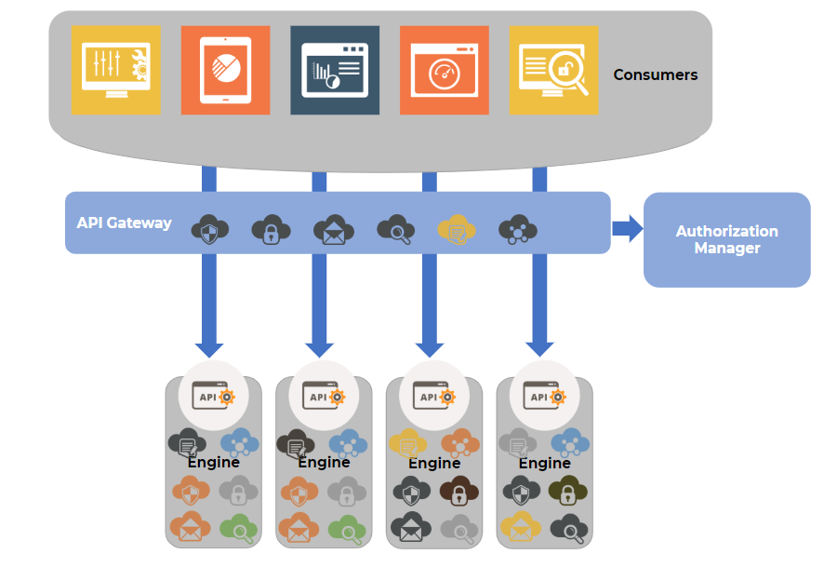
Microservice Architecture
Notes:
Uitleg algemene microservice architectuur
Als developer:
Separate the domains and
be carefull with the functionalities
Individually deployable

Slide 4
Language, framework and vendor independence
Separation of concern
Individual deployable units
Allows frequent software releases
Security for each Service
Allows parallel development
Benefits
Notes:
Vergelijking met NS
Individual deployable units: apart schaalbaar…

Slide 5
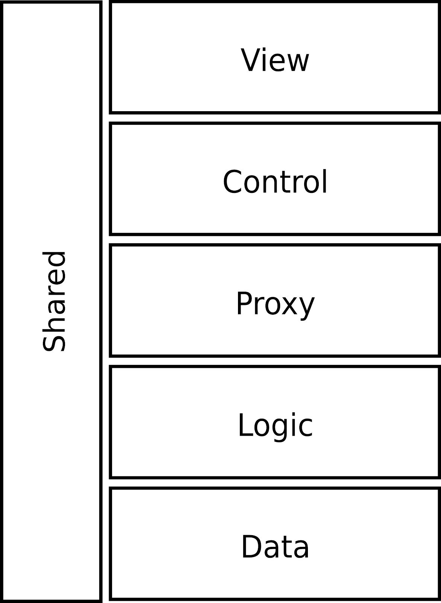
Api GateWay
NS to Engine
Notes:
RestConnector

Slide 6
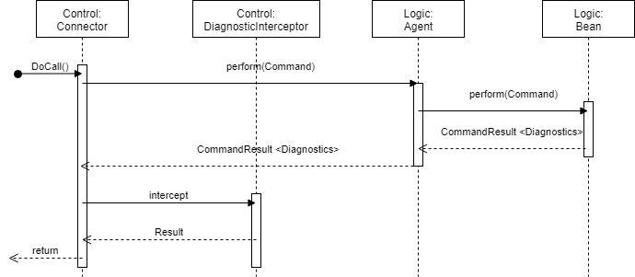

Slide 7
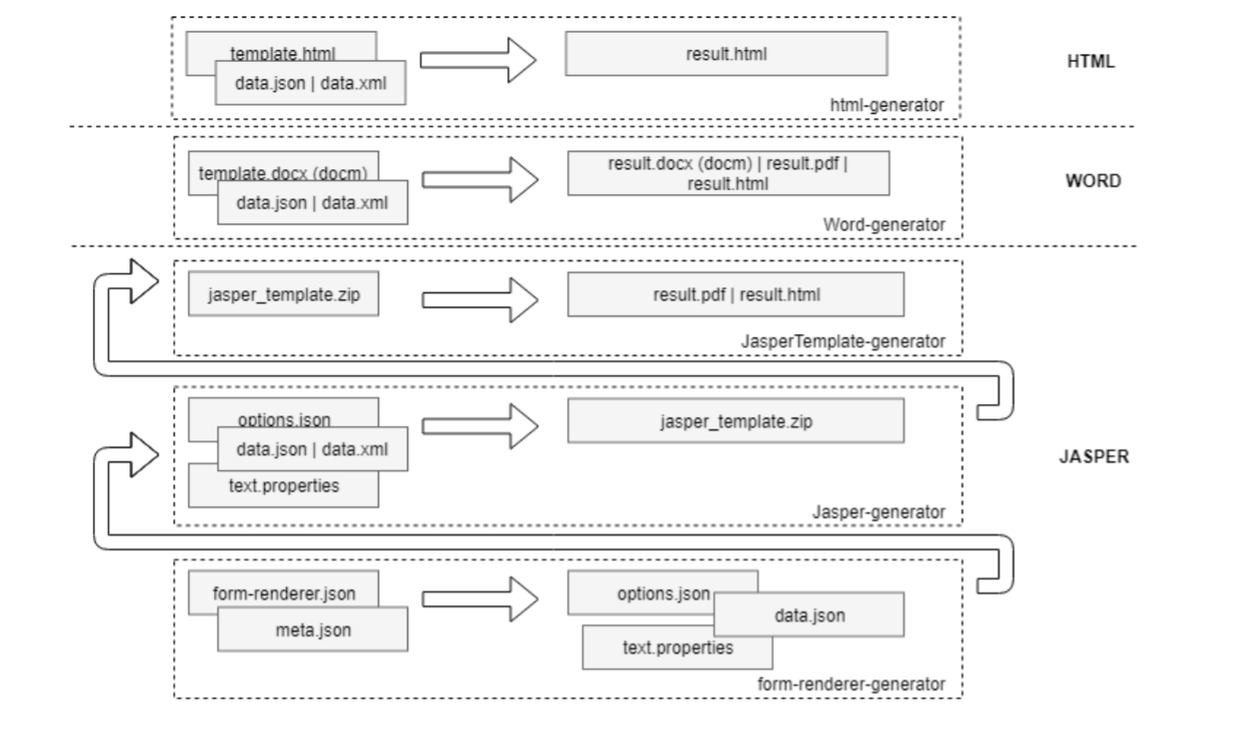
First Example
Output Generator
Notes:
Show Swagger

Slide 8
Generic platform to manage sensor inflow data
Receives data from multiple sensor types
Receives data via multiple input channels
Manage and backup data history
Forward data to subscribers
Second Example
IOT DataInflow Engine
Notes:
See Sven

Slide 9
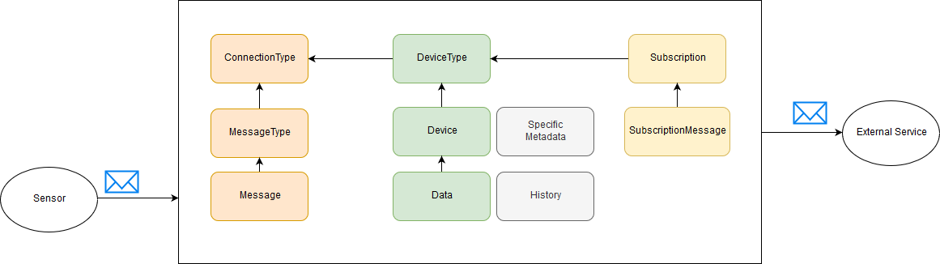
Version 1
Second Example
IOT DataInflow Engine
Notes:
Very specific build for predefined sensors
Only limited type of sensors supported
Also metadata was very specific (ParkingSpot, Barrier, Camera, ….)
Problems:
Channels for incoming data were not scalable + hard coupled to messageType
messageTypes were hard coupled to deviceTypes
Internal parsing of messages => new type requires new coding + deploy
metadata was specific for devices

Slide 10
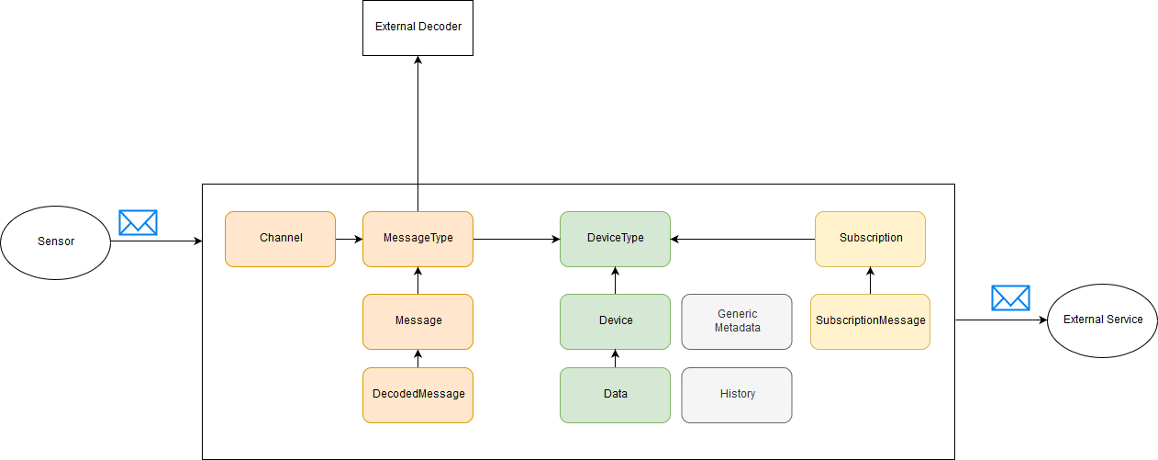
Version 2
Second Example
IOT DataInflow Engine
Notes:
Version2: generic
Solutions:
Introduce scalable channels unique coupled to messageType
Callback (unique per code)
TCP (unique per socket port)
MQTT (unique per topic)
External decoder to decode raw message to specific NSX format
Information includes deviceId/deviceType to couple data to devices
Generic metadata

Slide 11
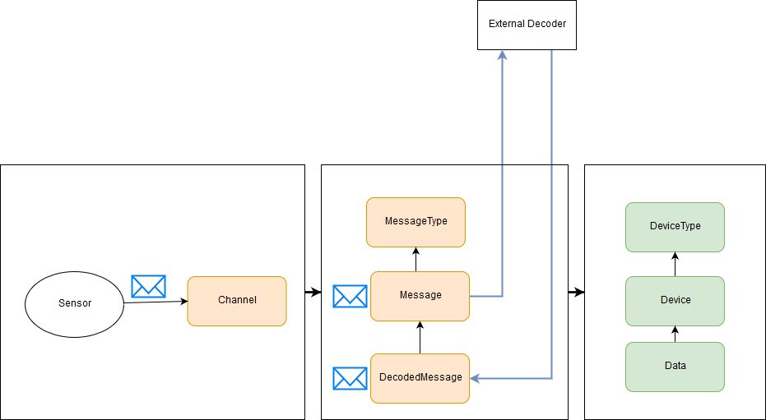
Advantages
  Scalable
Disadvantages
  Longer processing time => lower throughput
  Less control
Second Example
IOT DataInflow Engine
Notes:
Bad decoder can congest queue

Slide 12
Logging
Authorization
…
Cross-cutting concerns
Notes:
Logging:
1. App-logging
2. Logging via logging engine
3. Stoud -> logging engine kibana

Slide 13
Documentatie - JAX-RS
Swagger
SwaggerUI
Uitdagingen
Hergebruik

Slide 14
Docker
CI/CD
Notes:
DEMO:
C:\Users\Tim\Downloads\RentWorkflowBase\RentWorkflowBase
docker run -it -p 8080:8080 rentflowdemo
http://localhost:8080/rentFlowDemoApp/rentFlowDemoComp/car/all

Slide 15
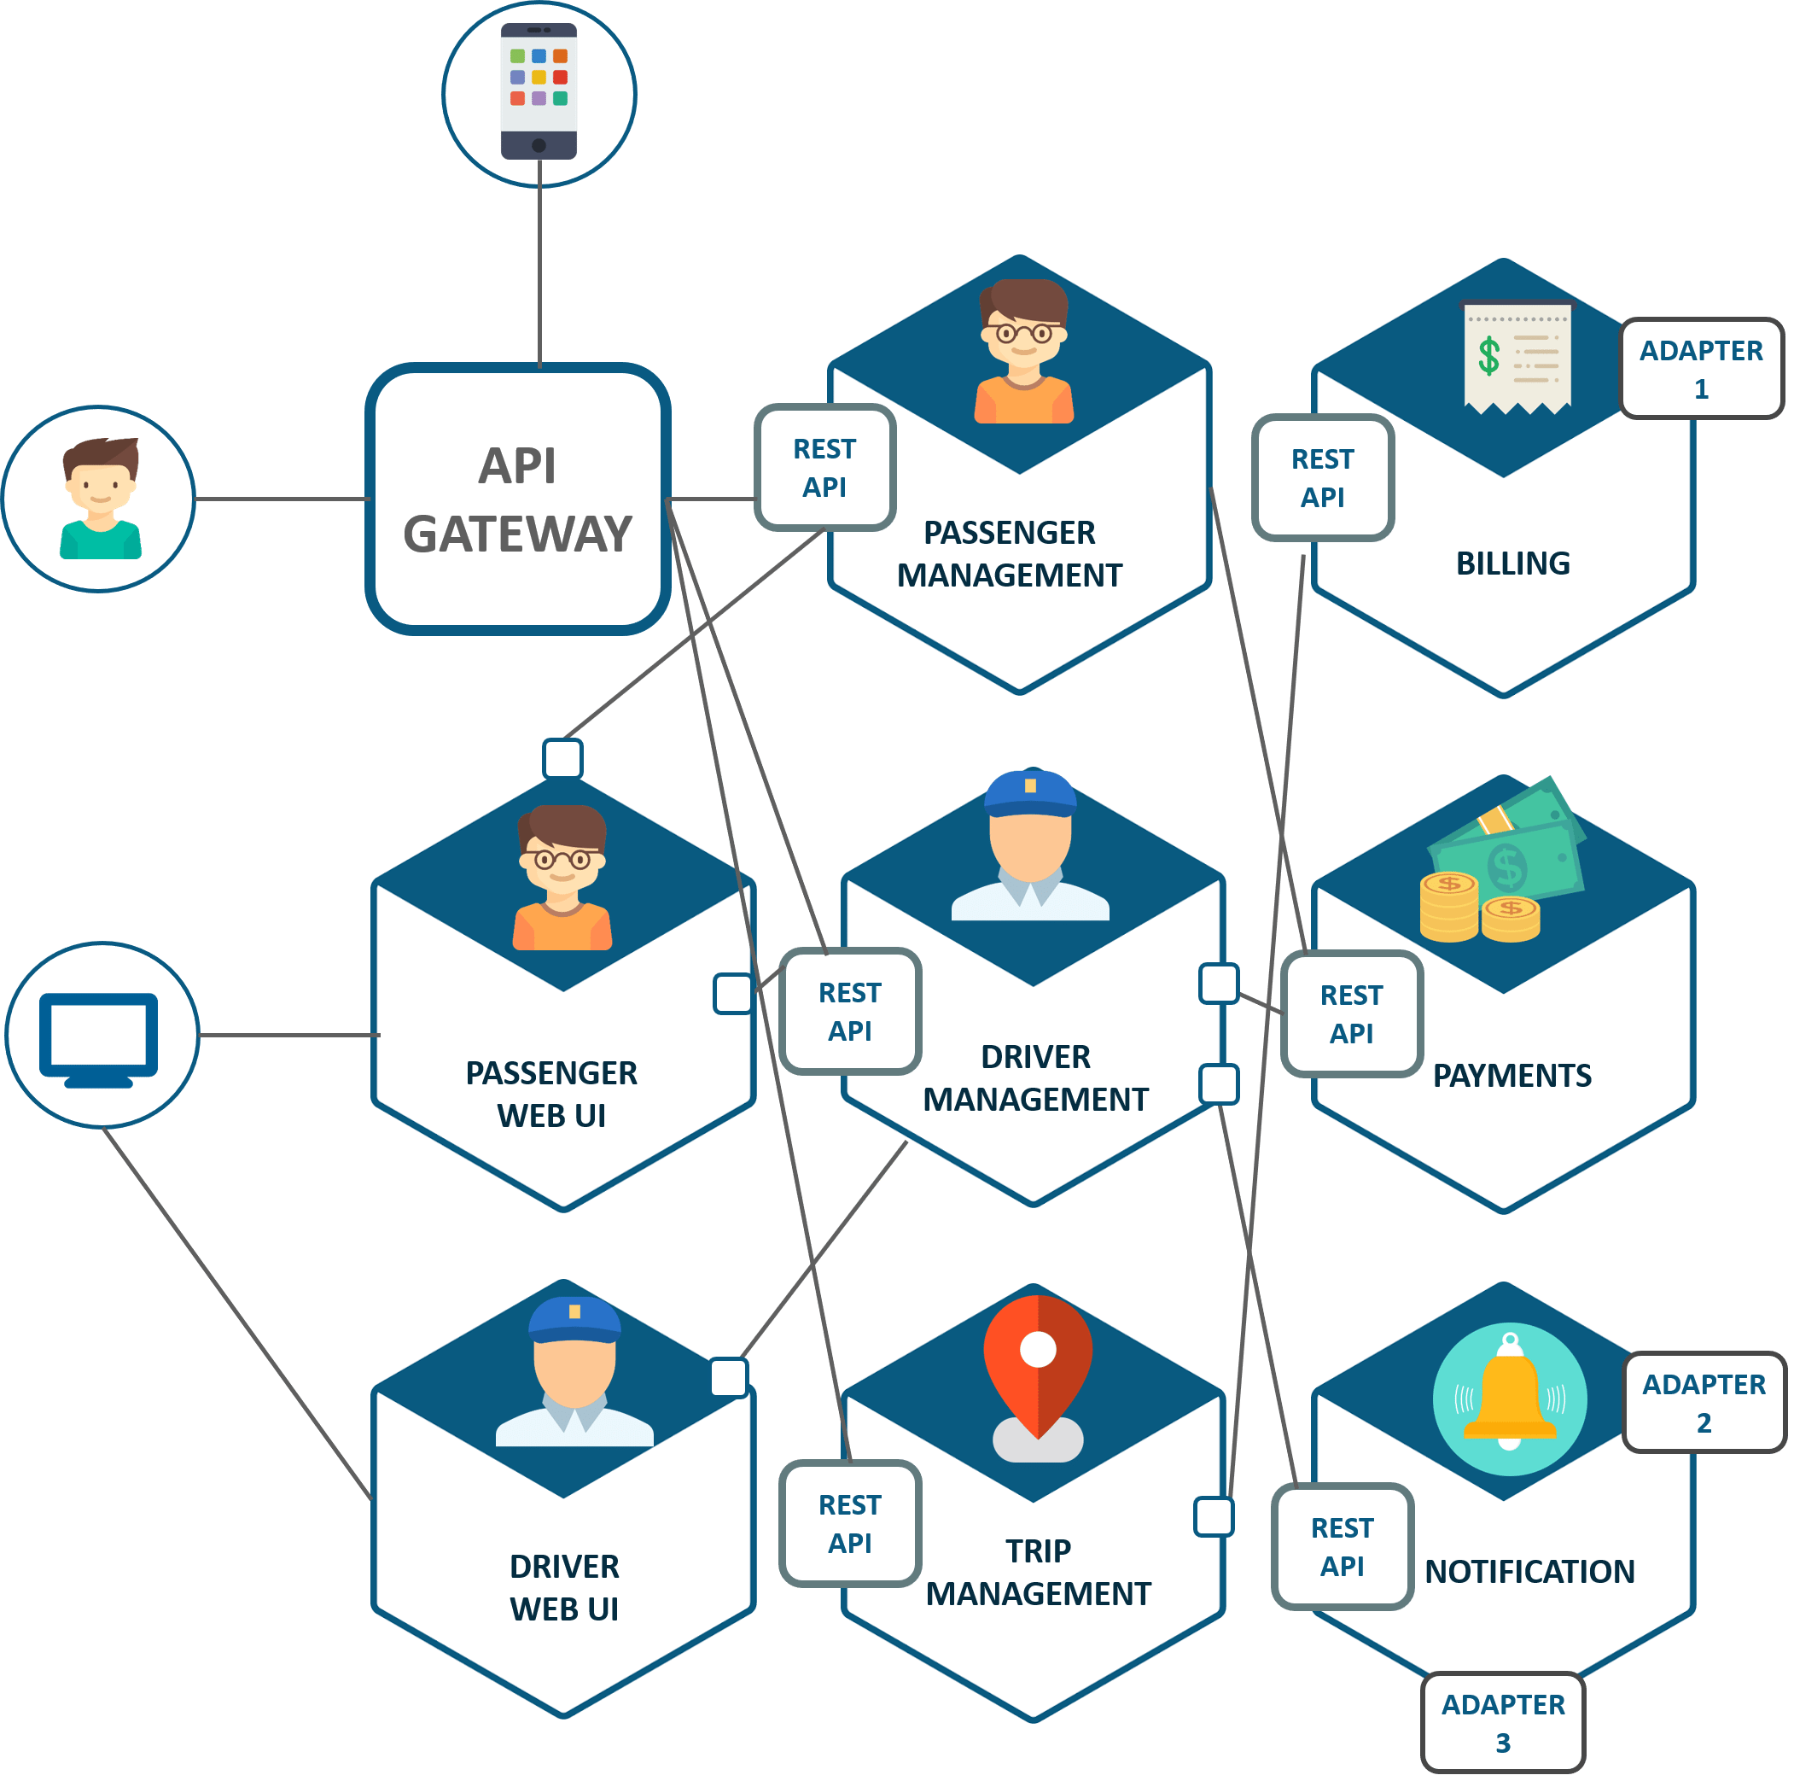
Synchronization
Notes:
Use case: Uber
Synchronized vs messages
Separation of state

Slide 16
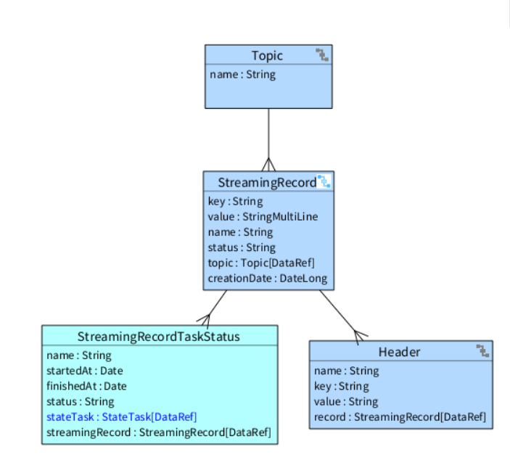
Apache Kafka Messages
Synchronization
Notes:
Demo: Streaming component
https://api-manager-app1-a.antwerpen.be/apiManager/relogin.action

Slide 17
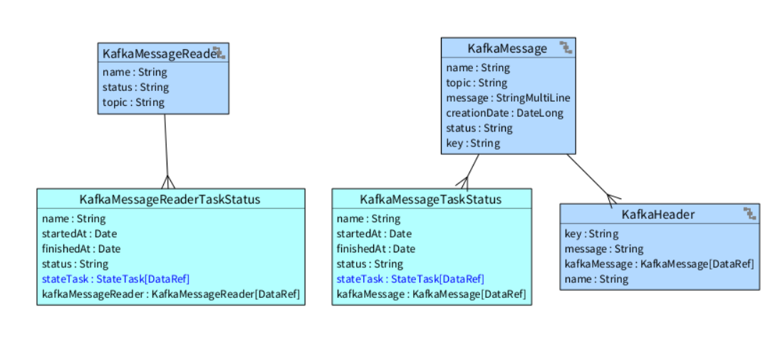
Notes:
Demo: Streaming component
https://api-manager-app1-a.antwerpen.be/apiManager/relogin.action

Slide 18
Data is distributed
Elastic Search
Search

Slide 19
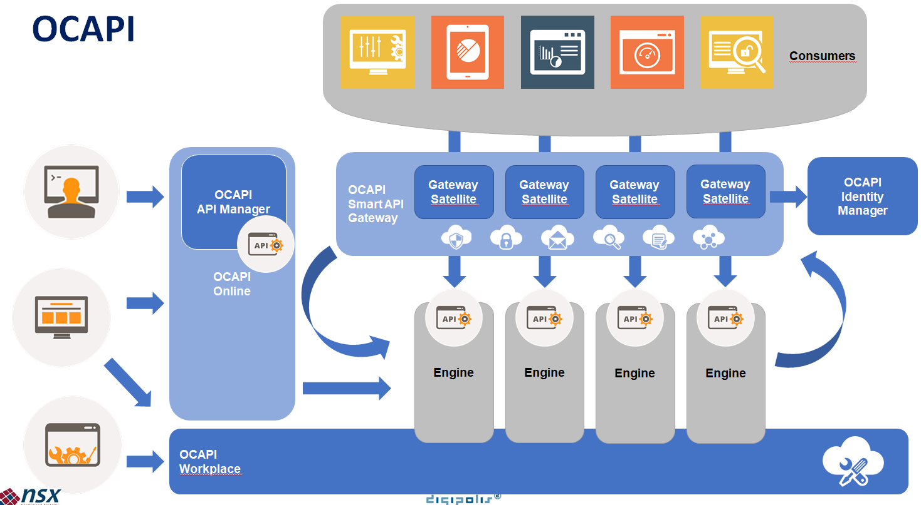
Sidecar Proxies
OCAPI
Notes:
Show Swagger

Slide 20
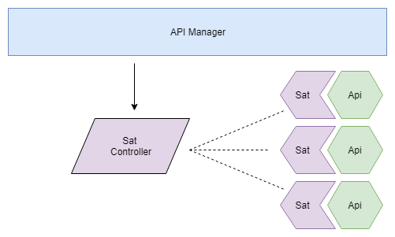
Cross-cutting concerns
Expanded shell vs Proxy App
Sidecar Proxies
OCAPI
Notes:
Logging
Auditing
Security
Traffic management
Latency-aware load balancing
SSL offloading
Metrics
Visibility / shielding
Failure recovery
Synchroon/asynchroon transformatie
Buffering
Circuit breaking
Data transformatie
Compliance met API Guidelines
Rate limiting

Slide 21
Is docker een technologie die gebruikt kan worden voor de NS tooling?
Is docker een technologie die gebruikt kan worden voor alle projecten?
Zijn er voordelen aan microservices waar we binnen NS-tooling naar kunnen kijken?
DISCUSSION
MICROSERVICES

Slide 22
Wat zijn de nadelen van microservices tov NS mbt aanpasbaarheid?
DISCUSSION
MICROSERVICES

