Slide 1
NS modeling – current state and the way forward for analysis and the NS meta-model

Slide 2
NS Modeling - Current state

Slide 3
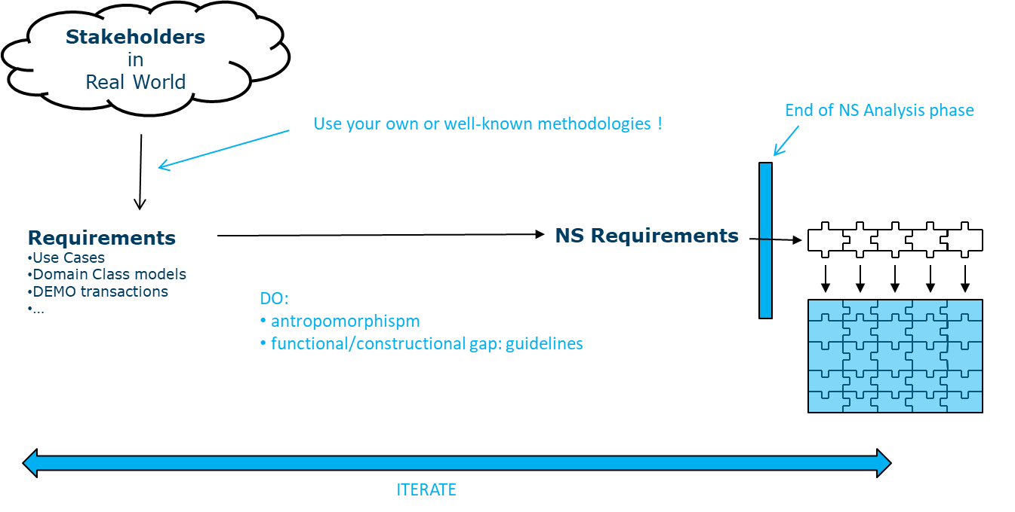
NS analysis and modeling requires the transformation of requirements into data, tasks and flows
FLOW
TASK
DATA

Slide 4
NS Modeling - Current state
Modeling of requirements

Slide 5
Data modeling happens using ERD diagrams

Slide 6
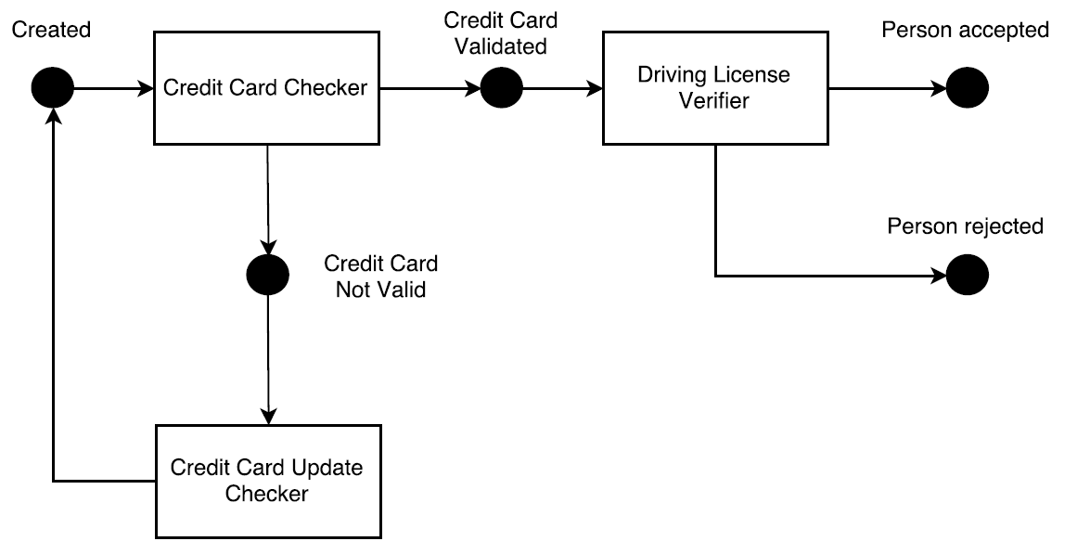
Process modeling happens using state diagrams

Slide 7
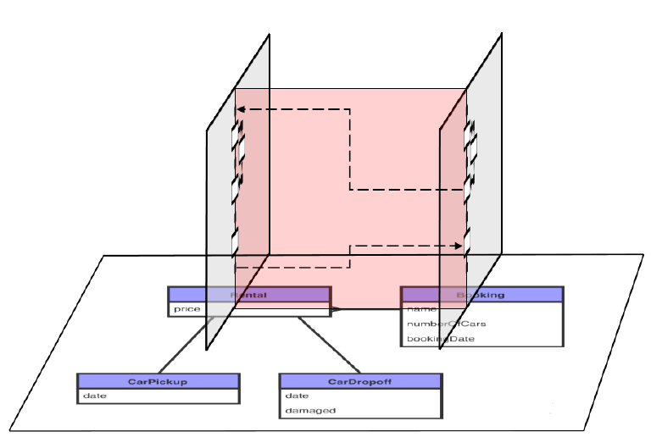
Data models and process models are conceptually interrelated

Slide 8
NS metamodel data dimensions: main/primary

Slide 9
NS metamodel data dimensions: taxonomy

Slide 10
NS metamodel data dimensions: directory

Slide 11
NS metamodel data dimensions: domain tables

Slide 12
NS metamodel data dimensions: proxy

Slide 13
NS metamodel data dimensions: combined view
Notes:
Benefits of dimensions:
looking at the data model from different angles
offers opportunities for checking the model for completeness

Slide 14
NS Modeling - Current state
Defining models

Slide 15
Models can be defined in different ways
Prime Radiant
  Via tables, no direct visual representation
  Many other possibilities, e.g., application generation, code expansion, etc.
Graphical modeling tool
  Developed by Peter Uhnak
  ERD modeling of data
  State machine modeling of tasks and flows
  Modeling of requirements “limited” according to the NS metamodel
    data dimensions (indication and showing/hiding)
    flows only on core data elements
    conventions
      some are automatically enforced
      others can be checked via validator
XML import/export for exchanging models
Notes:
NS Modeler
Taxonomie op/afklikken
State machines
NS specificities en conventies afdwingt
Interactie met PR
XML export/import -> vrij standard interface

Slide 16
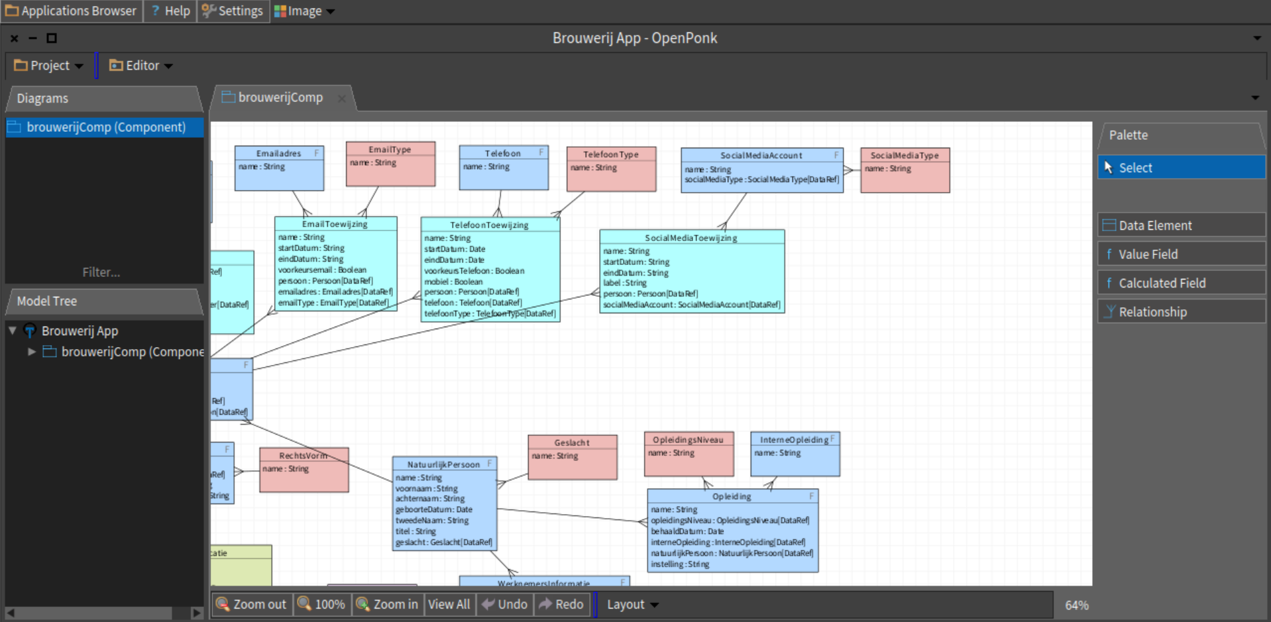
Demonstration of NS modeler

Slide 17
Limitations and the way forward

Slide 18
Limitations of the current modeling approach
Semantics on data model are limited
  Enrichment of entity relations?
    e.g., composition, sequential dependency, etc.
  Data dimensions are actually hierarchical
    dimension specification at the level of the relation more suitable?
Semantics on task/flow models are limited
  Hierarchical flows (cf. infra)
    Bridge/update/… interaction between flows
  Functional failed state vs technical failed state

Slide 19
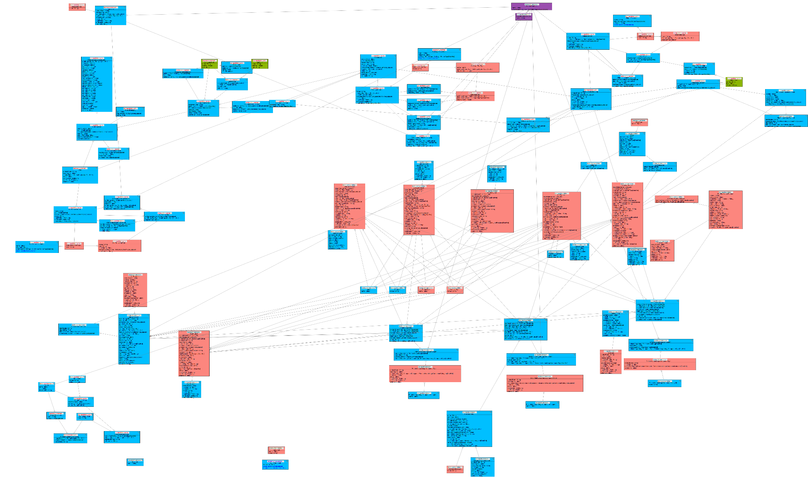
Illustration: Domain complexity
Notes:
In complex domains, the current visualization method is not sufficient to contain the complexities

Slide 20
Dealing with other (non-NS) ontologies
Other ontologies, having a more elaborate metamodel than NS, exist
  Some of them allow for code expansion (cf. MDA)
    fine-grained structure, evolvability, …?
  Some of them do not allow for code expansion
    how to transform the model in to code?
Research is directed towards the creation of a gateway ontology
  Enables the translation of a non-NS ontology into the NS “gateway ontology”
  Once a model is formulated in this gateway ontology, NS code can be generated
  This requires
    mappings
    extension of the NS metamodel/gateway ontology (many features of non-NS ontologies cannot be directly expressed in the NS metamodel/gateway)
  PhD research at University of Antwerp and TU Prague

Slide 21
NS meta-model as a Gateway Ontology
OntoUML
I*
FLOW
TASK
DEMO
DATA
FIBO
REA
Notes:
FIBO = Financial Industry Business Ontology
I* is an agent and goal-oriented modeling framework which analyzes intentional relationships among social actors (Yu et al. 2011). It is one of the most widespread goalmodeling approaches (Franch 2010)

Slide 22
Meta-model extensions: Hierarchical workflows

Slide 23
Hierarchical Flows
“Decomposing business process models into state machines, it is quite common to encounter so-called hierarchical workflows, i.e. the creation in a workflow of an instance of another data element, which triggers a secondary workflow.”
Related scenarios:
  The primary flow does not create the data element on which the secondary flow runs, but needs to be aware of its state (e.g., cancellation flows)
  More general: a primary flow is interested in the state of a secondary flow (instead of just being notified of the completion of the secondary flow)
Implementation should take into account:
  Separation of State
  Reducing coupling between primary and secondary flow (functional and technical)
Related patterns:
  Observer pattern
  Inversion of control constructs (e.g., callback methods)

Slide 24
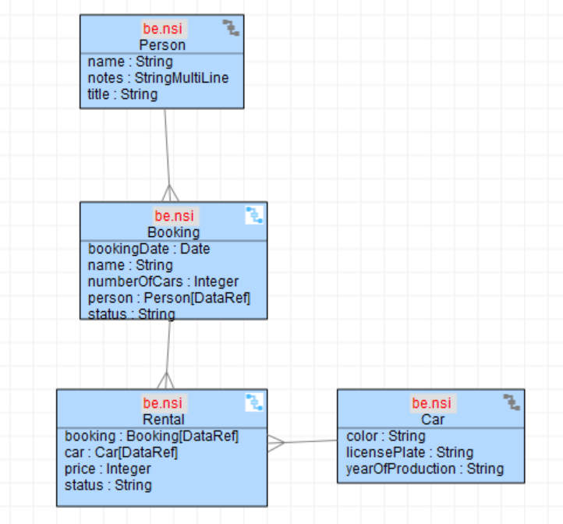
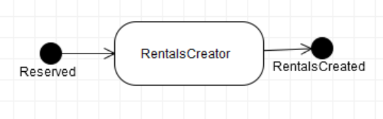
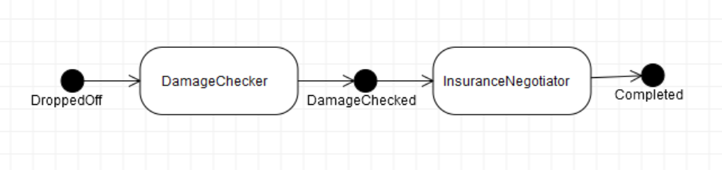
Universe of discussion: reduced EURent
?
Completed
M
DropoffRegisterer
Created

Slide 25
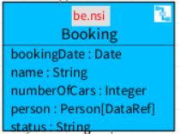
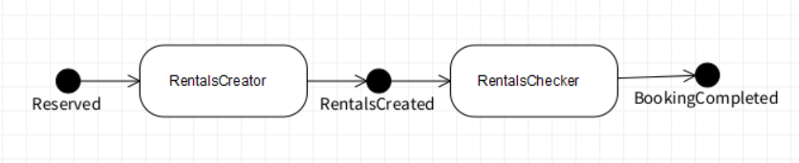
Solution alternative 1: polling
The primary flow is responsible for observing the secondary flow.
a RentalChecker task is added to the primary flow, which periodically checks whether the secondary flow has already completed.
The fail state of the related stateTask is then set to the begin state of that statetask. Alternatively, a branching task can be used.

Slide 26
Solution alternative 1: polling
Pros:
  Secondary flow is not aware of the primary flow. As such, coupling is unidirectional.
  All states (including fail states) of secondary flow can be observed.
  Added model artefacts have functional semantics.
Cons:
  Inefficient use of resources, limited scalability.
  Usage of failedState limits the observability of technical failures.
  Alternatively, a branching task could be used, but this couples the task implementation with its usage as a state task.

Slide 27
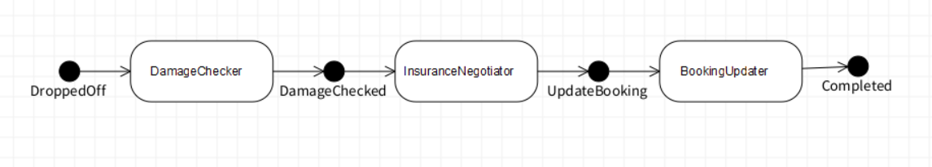
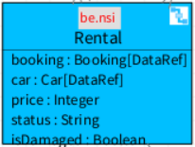
Solution alternative 2: update task in secondary flow
An updater task is added to the secondary flow, having the responsibility of notifying the primary flow.
Logic Bean of the primary flow data element exposes a method to be called, having the responsibility for performing the required business functionality to update its state.
Completed

Slide 28
Solution alternative 2: update task in secondary flow
Pros:
  Polling inefficiencies are reduced.
  Responsibilities are separated: secondary flow is responsible for triggering an update, while the primary flow keeps control over its own state.
Cons:
  Bi-directional dependencies could result in a technical issue in case the two workflows belong to a different software component.
  In some implementations, the secondary flow sets the state of the primary flow directly. This leads to tight functional coupling.
  Only successful completion of secondary flow is reported.
  Non-functional modeling artefacts are added.

Slide 29
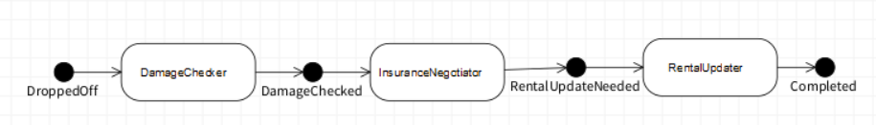
Solution alternative 3: Java PubSub mechanism
An updater task RentalUpdater is added to the secondary flow.
RentalUpdater notifies a list of registered observers upon completion of the secondary flow.
Subscription process is implemented using @Startup annotation (JEE6)
Completed

Slide 30
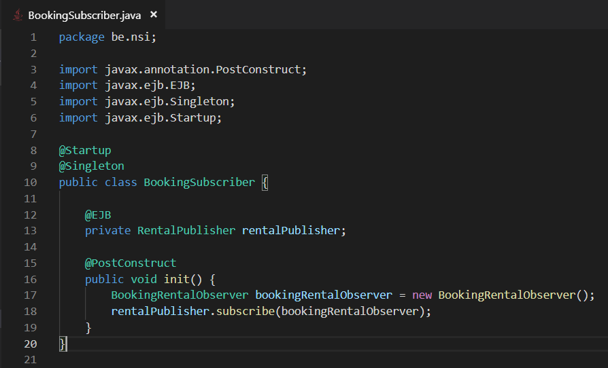
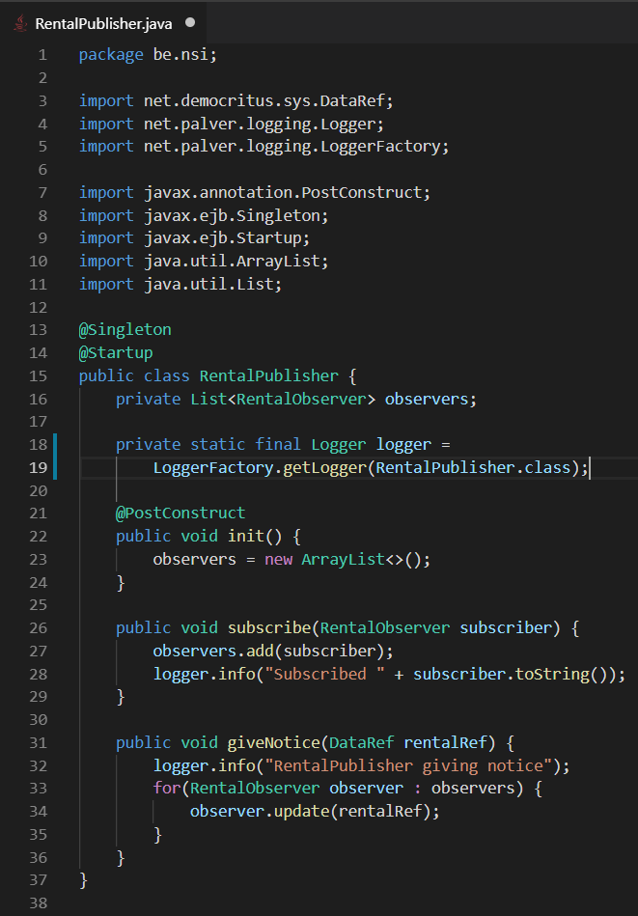
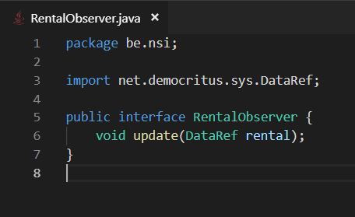
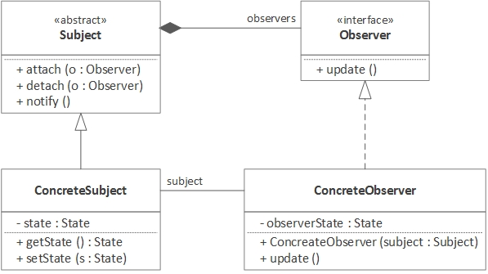
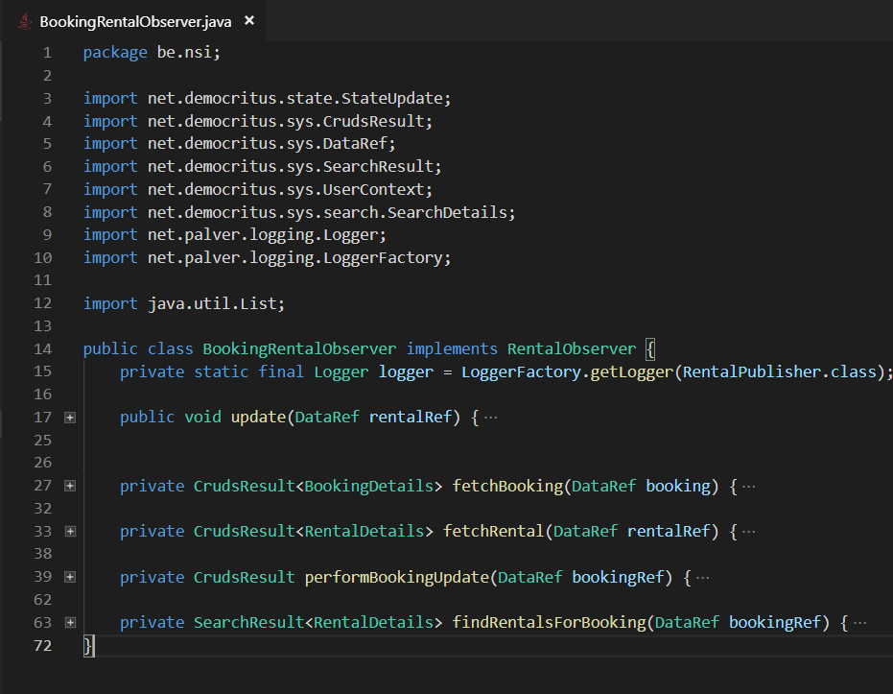
Solution alternative 3: Java PubSub mechanism

Slide 31
Solution alternative 3: Java PubSub mechanism
Pros:
  Similar to an updater task, but reduces the coupling from the secondary on the primary flow.
Cons:
  Robustness: difficult to handle exceptions from individual subscribers.
    One state reflects successful or erroneous notification of subscribers.
  Subscriptions are hardcoded using @Startup annotations
    Harder to monitor in multi-node environments.
  Only successful completion of secondary flow is reported.

Slide 32
Solution alternative 4: Messaging infrastructure
A RentalStatusPublisher session bean is created, which contains the logic to connect to a queue RentalQueue and publish a StatusUpdateMessage.
The method for publishing a status update is called from the compareAndSetStatus method on the RentalBean.
a MessageDriven bean BookingMessageProcessor which is configured to listen to the RentalQueue. Messages can be filtered before triggering specific business logic.
RentalQueue

Slide 33
Solution alternative 4: Messaging infrastructure
Pros:
  No direct coupling from secondary to primary flow.
  No “technical” model artefacts.
  Expansion of current customizations is feasible.
  Subscription can be configured instead of hardcoded.
  Enables updates for any status, not just secondary flow completion.
Cons:
  External technology (JMS) and infrastructure (queues) added
  Robustness should be safeguarded, especially in multi-node environments
    Ensuring messages get processed successfully (acknowledgement modes, durable subscriptions)
    Persisting to DB centralizes application state (multiple ActiveMQ brokers vs 1 DB instance)

Slide 34
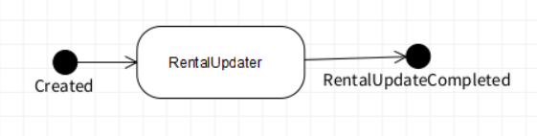
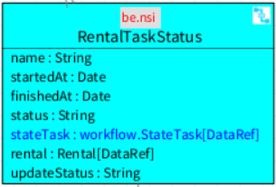
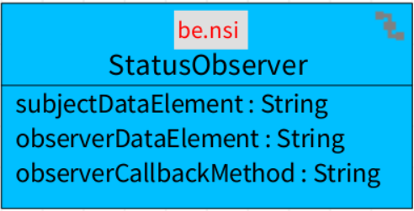
Solution alternative 5: flow on <secondary>TaskStatus element
A flow on a separate data element is responsible for triggering status update notifications.
Either a custom element, which is instantiated when a new status message needs to be sent, can be created, or the existing TaskStatus elements could be used for this purpose.
The updaterTask on this flow retrieves the observer elements from a configuration element (StatusObserver), dynamically loads an agent and triggers its notify() method.

Slide 35
Solution alternative 5: flow on <secondary>TaskStatus element
Pros:
  No model artifacts need to be added on the primary or secondary flows.
  No direct coupling from secondary to primary flow.
  No external technology needs to be used.
  Observer subscriptions can be configured at runtime (cfr. Flows) and persisted.
Cons:
  Dynamic class loading results in runtime exceptions.
  Non-functional model artefacts are added.

Slide 36
Solutions – functional variations / design decisions
Who is responsible for triggering update messages?
Which technology is used for notification?
Which state changes are communicated?
  Does failure of the secondary flow result in failure of the primary flow?
What is the multiplicity between primary and secondary flow?
  One primary flow listens to one secondary flow (Basic scenario, but occurs often in practice)
  One primary flow listens to multiple secondary flows (Each secondary flow notifies the primary flow, which decides on its own state transition)
  Multiple primary flows listen to one secondary flow (Highlights the coupling / dependency from secondary on primary flow)
  Multiple primary flows listen to multiple secondary flows
“Notifying” the primary flow can be handled differently
  State can be set directly
  Business logic to decide on state change can be triggered
  Parking state field can be used

Slide 37
Meta-model extensions: Inheritance

Slide 38
Inheritance in conceptual modeling
Discussed in Evolvability Evaluation of Conceptual-Level Inheritance Implementation Patterns (Marek Suchánek and Robert Pergl)
Inheritance is a well-known and often-used construct in conceptual modelling.
Subclassing is often used to enable reusability and to modularize complex applications, distinguishing accidental from essential use of inheritance.
Evolvability problems caused by inheritance in Object-Oriented Programming are well-known: e.g., “composition over inheritance”, GoF
Previous research concerned the transformation of OntoUML to UML and relational models.

Slide 39
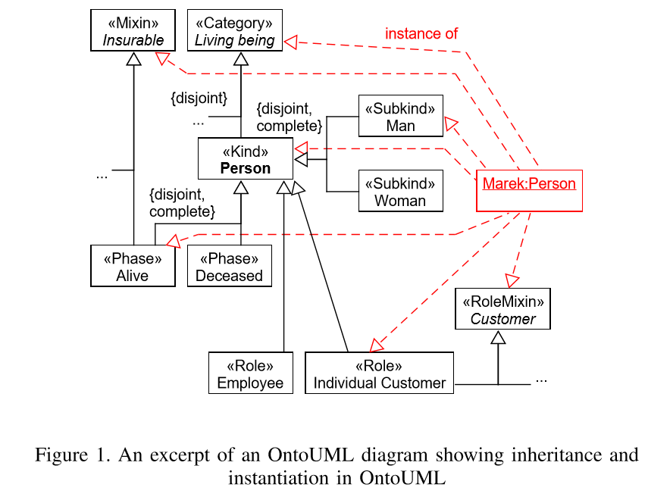
Universe of discussion
The identity principle from OntoUML deﬁnes the methods to determine if two apparent instances of the same concept are actually the very same individual.
The types of universals that provide the identity principle for their instances are called Sortal universals (e.g., kind, subkind).

Slide 40
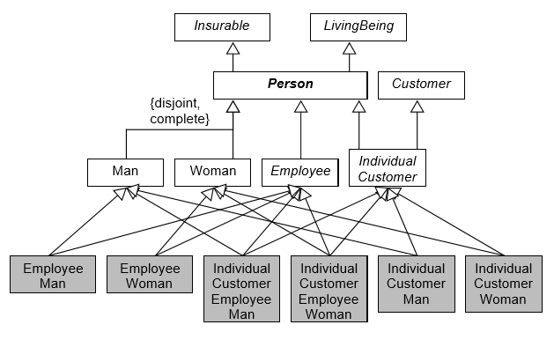
Traditional OOP Inheritance
Requires either multiple inheritance, or large-scale duplication of attributes.
Adding additional classifications such as alive and deceased result in 16 instead of 8 required classes (2^{n} classes are needed)
Rigidity: changing an AliveEmployeeWoman to DeceasedEmployeeWoman requires transformation procedure
Adding or removing conceptual classes invalidates customizations

Slide 41
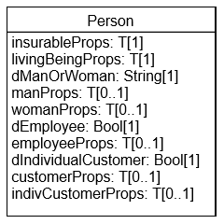
Union Pattern
Cfr. Single Table Inheritance
A single class unions all properties, and adds discriminator properties
Adding a new subclass results in a definition of a new discriminator value and new fields.
Data integrity must be validated manually.

Slide 42
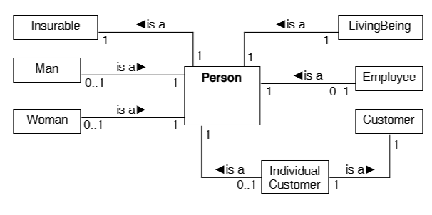
Composition Pattern
Similar to Union Pattern, but does not require discriminators
All generalization relations are replaced by bidirectional is-a relations.
Every (conceptual) abstract class is turned concrete and must be instantiated and linked to the Person class.
Easier to expand data integrity validations.
Conceptual changes have limited impact on existing customizations.

Slide 43
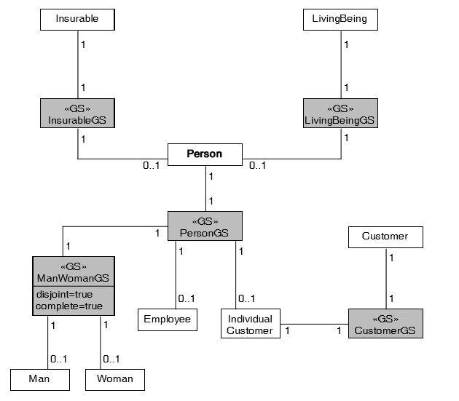
Generalization Set Pattern
Like the composition pattern, but separates the concern of validating conceptual inheritance constraints.
For each conceptual class which has subclasses, a <<GS>> class is generated. These can provide integrity checks for e.g. complete and disjoint qualifiers.

Slide 44
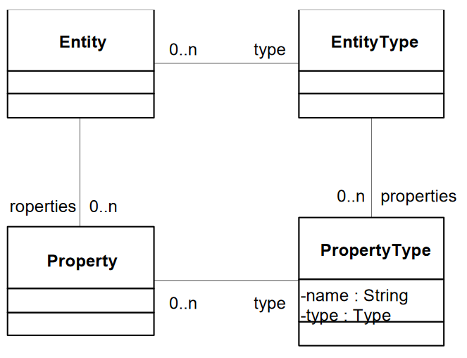
Inheritance - discussion
Different patterns have pro’s and cons, depending on the depth of the inheritance tree.
Inheritance challenges have also been observed to be solved through generic modeling (EAV), cfr Architecture and Design of Adaptive Object-Models, Yoder et al.
Different NS layers need to be considered (i.e., UI vs API vs DB queries)

Slide 45
Meta-model extensions: discussion

Slide 46
Discussion
OntoUML describes well-defined conceptual constructs
REA contains domain knowledge from the accounting domain
DEMO
  Transaction pattern
  Process Model (business model as a tree of transactions)
  State Model primitives
  Action model
Domain-Driven Design
  Aggregate roots define limitations for entity access
Microservices
  Sagas are preferred over distributed transactions

